Slide 1
Modelling Energy, the Environment and the Economy
Cambridge Econometrics Training Course
Hector Pollitt
September 2015
Notes:
The

Slide 2
Overview
How the E3 interactions are modelled in the energy sub-model
Environmental emissions in E3ME
Modelling the economic impact of a carbon tax
Notes:
The

Slide 3
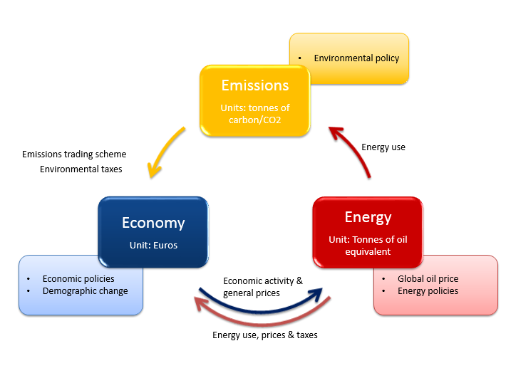
Energy-Environment-Economy interactions

Slide 4
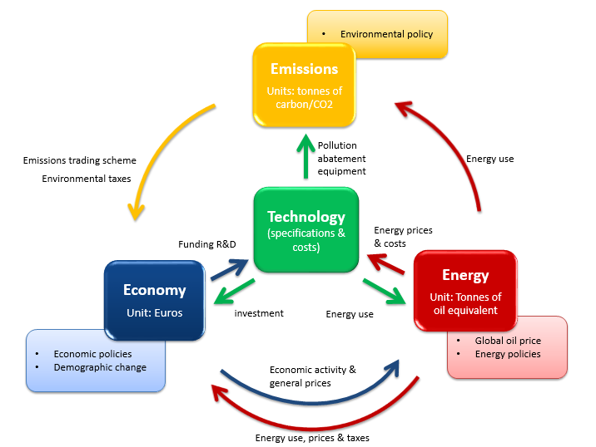
Engineering-Energy-Environment-Economy interactions

Slide 5
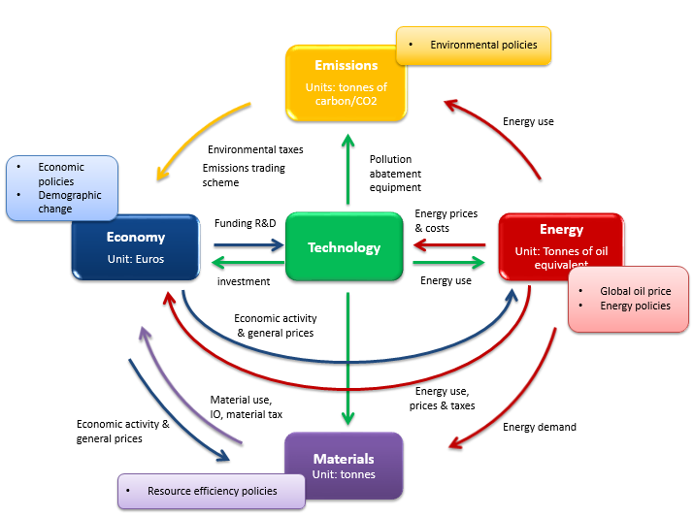
Engineering-Energy-Environment-Economy interactions

Slide 6
The energy sub-model
Determines final energy demand (by fuel and user) and prices of fuel use
Provides feedback to main economic framework
This 'top-down' approach is intended to be supplemented by a set of 'bottom-up' engineering sub-models
  the current model version includes a detailed treatment of the electricity supply industry (FTT)

Slide 7
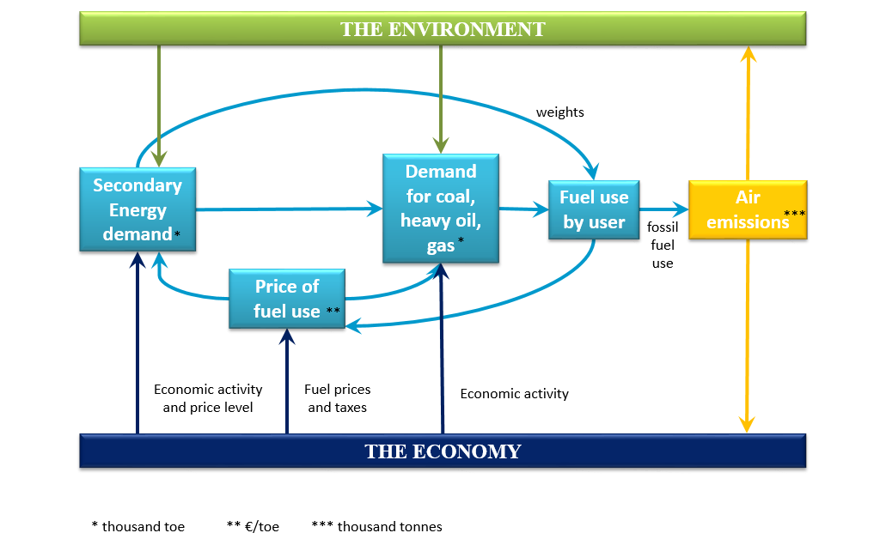
The energy sub-model

Slide 8
Aggregate energy demand functions
No explicit production function
Energy demand as derived from demand for heat, power etc. and in turn from demand for products
2-level hierarchy: aggregate energy demand equations and fuel share equations
Aggregate demand affected by industrial output of user industry, household spending in total, relative prices, technical progress

Slide 9
Fuel share equations
This aggregate demand then shared out among main fuel types (coal, fuel oil, gas and electricity)
Fuel share equations depend upon:
  activity, technology, relative price effects
Total demand is scaled to match the results from the aggregate demand equation

Slide 10
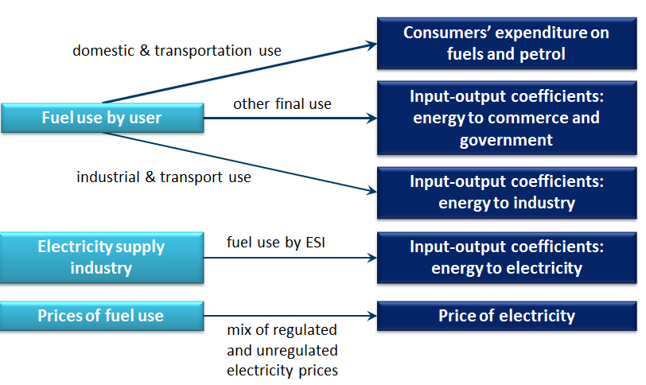
Feedback from the Energy Sub-model

Slide 11
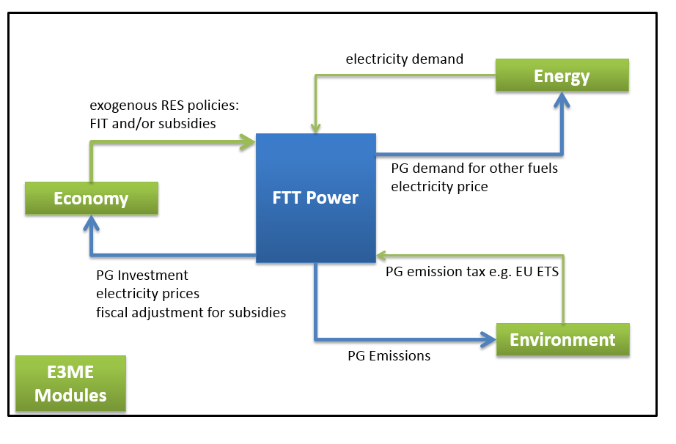
FTT and E3ME Model

Slide 12
Prices in the Energy Sub-model
Prices are determined as follows:
  fossil fuel prices facing user linked to assumptions on oil, gas and coal production prices
  electricity prices from the FTT linked to cost of generation, transmission, distribution, and supply
Policy measures affect the prices e.g.:
  UK Climate Change Levy, carbon/energy tax, EU ETS etc....
Revenue from any energy tax may be used in main model, depending on the assumptions:
  recycle carbon tax revenues as reduction in employer taxes
  reduce direct/indirect tax burden

Slide 13
Energy in E3ME
Based on IEA data
Treatment is mainly by econometric equations
Fuel demand by power generation comes from an energy technology sub-model (the FTT)

Slide 14
Treatment of environmental emissions
Emissions are analyzed by type and source
Data from EDGAR database
Indicators of source activity are projected and the underlying assumption made that the emission/source coefficient is predictable
Projections of fuel use by user and type determine much of the emissions, allowing for different fuel quality/combustion processes
The projections allow for achievement of selected trans-boundary pollution targets for the EU

Slide 15
Valuing damages from air pollution in E3ME
An example for EU regions
method: use of ExternE valuations of damages by 4 pollutants (SO₂, NO_{x} and PM₁₀, VOCs)
marginal costs applied through scenario analysis
damages are assigned to the region inflicting the damages
damage costs are dominated by costs to human health and use values of life-years lost for premature mortality, rather than values of statistical life
currently damage coefficients are available for the EU regions only

Slide 16
Effects of GHG mitigation on air pollution in E3ME (OECD 2000 paper)
GHG mitigation leads to significant reductions in some damaging externalities at no extra cost
The value of lower SO₂, NO_{x} and PM₁₀ estimated for the EU to achieve Kyoto target ranges between
  ... 0.0 to 0.3 of GDP compared with
  ... direct mitigation costs of -0.8 to 0.3 of GDP in 2010
The values of ancillary benefits are expected to halve 1995 to 2010 as non-GHG policies reduce pollution
The values are likely to be underestimates
  only 3 pollutants, not in cities, only known effects, not traffic-related
  ExternE uses values of life years lost, not value of a statistical life
  no allowance for higher valuations as incomes grow

Slide 17
Energy and emission classifications in E3ME Version 6
FU:22 (fuel users)
Power Generation
Own use
Iron & Steel
Non-ferrous Metals
Chemicals
Mineral Products
Ore-extraction
Food, Drink & Tob.
Tex., Cloth. & Foot.
Paper & Printing
Engineering etc
Other Industry
Construction
Rail Transport
Road Transport
Air Transport
Other Transport serv.
Households
Agriculture, forestry, etc.
Fishing
Other Final Users
Non-energy use
J:12 (fuels)
Hard coal
Other coal etc
Crude oil etc
Heavy fuel oil
Middle distillates
Other gas
Natural gas
Electricity
Heat
Combustible waste
Biofuels
Hydrogen
EM:14 (air emissions)
CO₂
SO₂
NO_{X}
CO
Methane
Black smoke
VOC
Nuclear - air
Lead - air
CFCs
N₂O (GHG)
HF₆ (GHG)
PFC (GHG)
SF₆ (GHG)

Slide 18
Macroeconomic modelling of mitigation policies
Sectoral approach helpful (c/f aggregate models)
  substitution by gas is an important mitigation option
  fuel-using sectors (power, transport, residential) have different costs of mitigation
  carbon-saving capital can use very different technologies (CCGT’s, car engines, dwellings)
Use of fuels depends on capital stock, so short-term price responses may be low

Slide 19
Mitigation options modelled in E3ME
Carbon taxes and emission trading schemes
  with alternative recycling options, i.e. via reductions in income taxes, labour taxes or indirect taxes
  covering different areas
  allowing exemption/lower rates for energy-intensive industries
Subsidies for new technologies
  guaranteed prices for renewable electricity
Funding/support of R&D
  general R&D support
  support for energy saving and low-carbon processes

Slide 20
Revised energy demand treatment
Still in development phase
Ideas so far
  new specification for energy equations
  re-defining the technological change variable
  inclusion of a temperature variable

Slide 21
The Emissions Trading Scheme
Original EU & ETS work done by CE for Swedish government
More recently work carried out for the EC’s Impact Assessment

Slide 22
The EU ETS in E3ME
Power and industrial fuel users are included in the EU ETS:
  power generation
  rest of energy branch
  iron and steel
  non-ferrous metals
  chemicals
  non-metallic mineral products
  paper and pulp
  other industry
Sectoral (and geographical) coverage can be modified easily

Slide 23
The ETS in E3ME (cont.)
The EU ETS is fairly stylised:
  allowances are treated as taxes on energy use, depending on the carbon content of fuels
  these cost increases are passed on to consumers
  prices may be entered exogenously or calculated by the model – however, market clearing is assumed
  allocated allowances are used to increase profits
  there are no links to areas outside the EU or JI/CDM schemes
  there are no awareness or signalling effects
  there is no feedback to energy prices, which are exogenous

Slide 24
Macroeconomic impacts from a carbon/energy tax
carbon tax / energy tax
Environment
Government
carbon / energy content
tax rates by fuel and user (including tax)
CO₂ emissions from solid fuel, oil and gas
fuel use by fuel and user
exports
industrial output
industrial employment
Industries & Households
imports
industrial prices
industrial wage rates

Slide 25
Macroeconomic impacts from a carbon/energy tax
carbon tax / energy tax
Government
carbon / energy content
tax rates by fuel and user
tax revenues
tax on primary energy consumption
reduction in other taxes
fuel prices
inflation
taxes passed on
domestic supply prices
import prices
prices
wages
Industries & Households
industrial prices
imputed tax liability
electricity prices
Notes:
Examples: macroeconomic impacts from carbon and energy taxations

